Slide 1


The Pensions Ombudsman
– an update
Mairi Spiby, Stakeholder Manager
Occupational Pensioners Alliance (OPA) AGM
Riverside Arts Centre Sunbury-on-Thames
May 28 2019

Slide 2

The Pensions Ombudsman
Impartial
Substantial powers
Unlimited redress
Legally binding
Funded from levy from pensions industry

Slide 3

What The Pensions Ombudsman can investigate
All occupational pension schemes and all personal pension schemes
Some decisions of the Pension Protection Fund (PPF) and complaints of maladministration
Some decisions made by the PPF as manager of the Financial Assistance Scheme (FAS)

Slide 4
We’re changing
Responding more effectively to the needs of our customers (complainants and those complained about)
  Rapid response
  Accessibility to the service
  Better informed customer
Provide a swift and low cost alternative to the courts (in our case, a free alternative)
Gentle but relentless increase in demand for our service

Slide 5

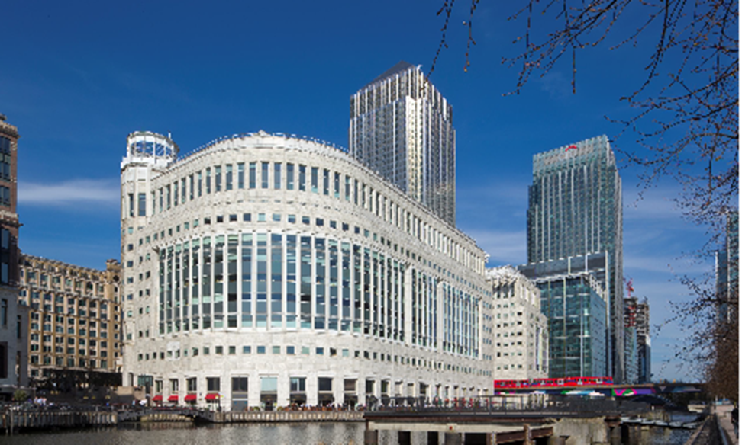
A smart new office …

Slide 6

… and even smarter working

Slide 7
Simplifying the customer journey
The Pensions Ombudsman welcomed the dispute resolution team from The Pensions Advisory Service (TPAS), plus 240 volunteers – March 2018
Money and Pensions Service now provides information and guidance on pensions
The Pensions Ombudsman deals with pension-related disputes
Early Resolution Service customers are not expected to have first used a scheme’s internal dispute resolution procedure (IDRP) if the parties are in agreement

Slide 8
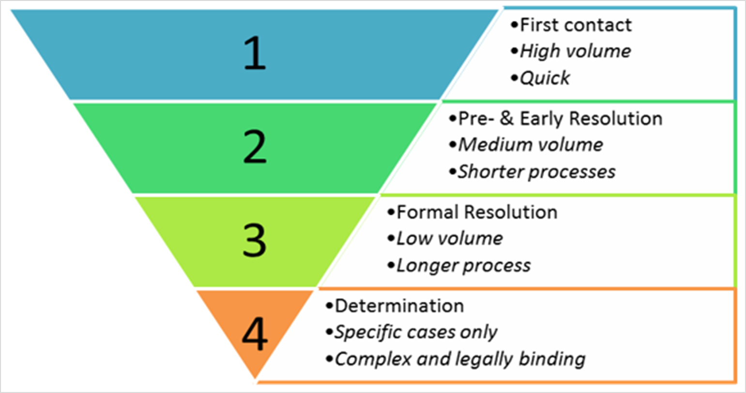
A new way of looking at things

Slide 9

Clearer signposting for dispute resolution
Improved signposting is set out in the Financial Conduct Authority’s (FCA) handbook – April 2018
The Department for Work and Pensions (DWP) and The Pensions Regulator (TPR) sign agreement clarifying signposting – September 2018
DWP launch a public consultation seeking views on new provisions for dispute resolution by The Pensions Ombudsman – December 2018

Slide 10
Updated memorandum of understanding between The Pensions Ombudsman and the Financial Ombudsman Service ‒ December 2017
The Pensions Ombudsman deals with matters that predominately concern administration and/or management of occupational and personal pension schemes
The Financial Ombudsman Service deals with matters that predominately concern advice in respect of sales or marketing of individual pension arrangements

Slide 11
Non-financial injustice - examples
‘Distress’: disappointment, concern, anxiety, anger
‘Inconvenience’: the time and effort spent by the complainant in relation to the maladministration and in having to pursue their complaint

Slide 12
Non financial injustice – relevant cases
Baugniet v Capita Employee Benefits Ltd [2017]
Urged to rebase the ‘upper limit’ of awards for non-financial injustice, for conduct falling short of exceptional, from £1,000 to £1,600
Smith v Sheffield Teaching Hospitals NHS Foundation Trust [2017]
The award should be above the top end for conduct falling short of exceptional – awarded £2,750

Slide 13
Non-financial injustice – redress
No award | Nominal non-financial injustice
£500 | Significant non-financial injustice
£1,000 | Serious non-financial injustice
£2,000 | Severe non-financial injustice
Higher than £2,000 | Exceptional non-financial injustice

Slide 14
The Courts – participating in appeals
Previous position. The Pensions Ombudsman only participated if:
the matter was likely to affect the Ombudsman’s jurisdiction or procedures
Now. The Pensions Ombudsman may also participate if, for example:
the decision is likely to have a wider impact on the industry
there are a large number of same-issue cases awaiting investigation
there is a real and significant concern over access to justice (see Butterworth v Manchester Police Authority [2016])

Slide 15
Scams or pension liberation
The Pensions Ombudsman has adopted new approaches, for example…
Talking to complainants to explain legal position, concerns and options
Hughes v Royal London Insurance Company [2015].
Positive outcome ‒ legislation banning cold-calling and
safeguards to be added to the statutory right to transfer

Slide 16
The
The numbers 2018-2019
90 staff
Approximately 6,20 written enquires and 7,400 phone enquires
Accepted approximately 3,900 new Early Resolution Team (ERT) cases (incl 1350 ‘quick responses’)
Completed approximately 3,500 ERT cases (incl 1300 ‘quick responses’)

Slide 17
The
The numbers 2018-2019
Accepted approximately 1,500 new investigations and rejected 330 for being outside jurisdiction, etc.
Completed approximately 1,260 investigations
Reduction on last year, due to relocation, change of working practices, staff shortages, change IT and introduction of new casework management system
Average time to close a case (from application) reduced to 4.5 months (5 months last year)

Slide 18
Stakeholder relationships- who are we working with?
Regulators, Ombudsman, oversight bodies
Consumer Groups , Federations & Unions
Public Sector Pension Schemes
Stakeholder Relationships
Master Trusts & Trustee Providers
Public Sector Pension Boards
Private Sector Pension Providers

