Slide 1
Occupational Pensioners’ Alliance:
An update from the PPF
Lisa McCrory, Chief Actuary
Chris Collins, Chief Policy Adviser
7 March 2019

Slide 2
What you can expect today
A quick recap on the PPF
The Purple Book 2018
The current landscape
Scheme funding
Scheme demographics
Asset allocation
Risk reduction
Insights
The future landscape

Slide 3

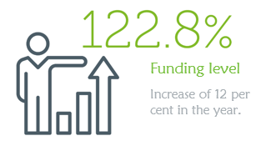
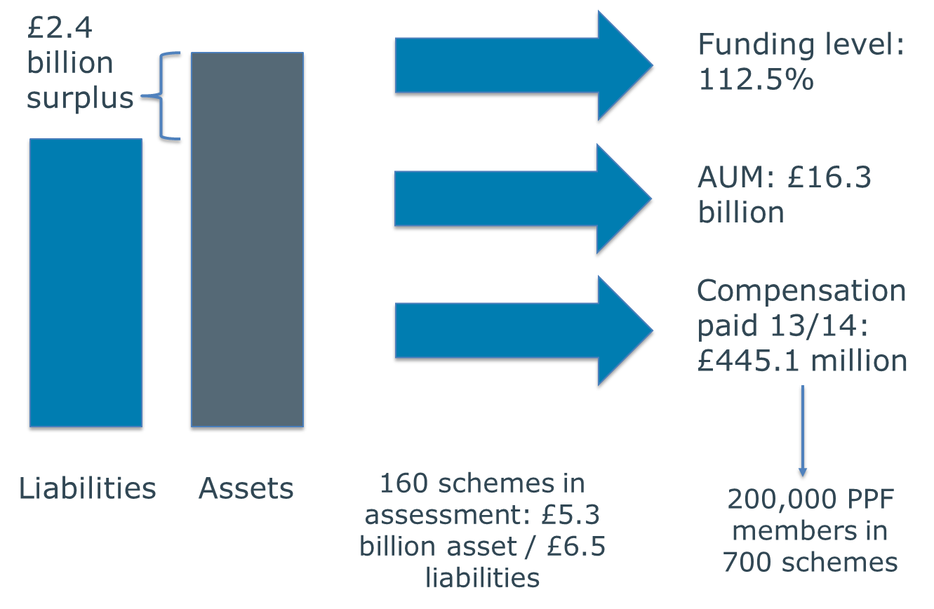

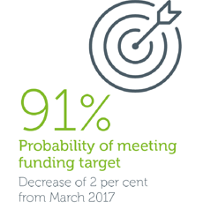


The PPF in numbers
115.1%
Long Term Risk Model (LTRM)
£23
88%
Probability of hitting our long term funding target
14/15
£564 million
115 schemes in
assessment
236,000 PPF members in +900 schemes
Source: PPF Annual Report,
2017/2018

Slide 4
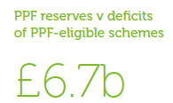
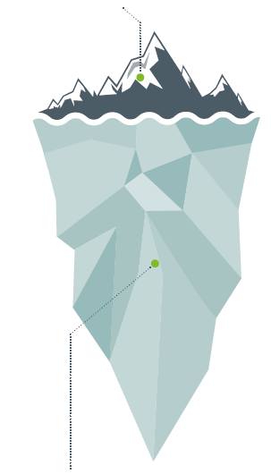
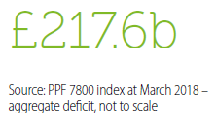
We’re in good shape … …but the future still holds political and economic uncertainty

Slide 5
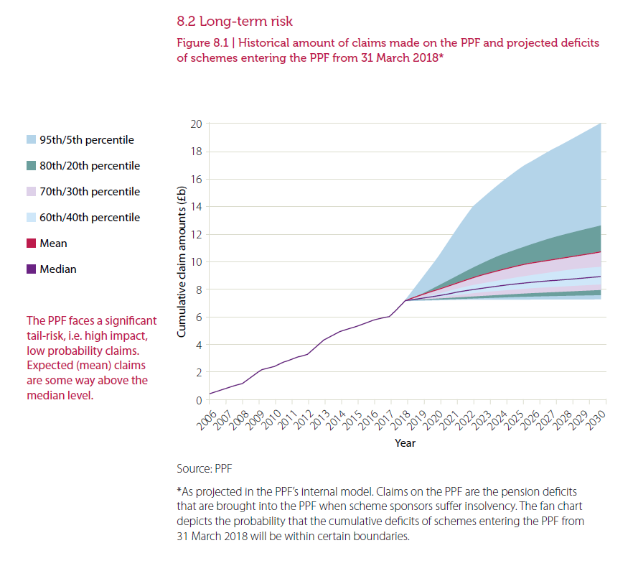
PPF claims projections

Slide 6
The Purple Book 2018
13th edition
The most comprehensive picture of the risks faced by PPF-eligible defined benefit (DB) pension schemes
Based on a sample of 5,450 schemes, 98.7% of universe
Most of the data comes from scheme returns sent to The Pensions Regulator
Quality of data very good; has to be cleaned for levy bills

Slide 7
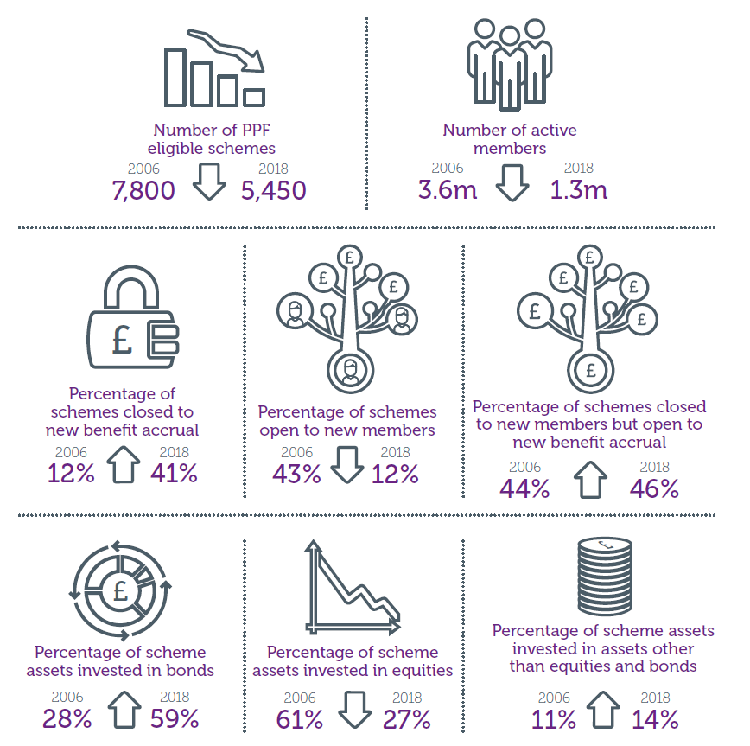
Pensions landscape – changes to PPF eligible universe (I)
Source: PPF Purple Book,
December 2018

Slide 8
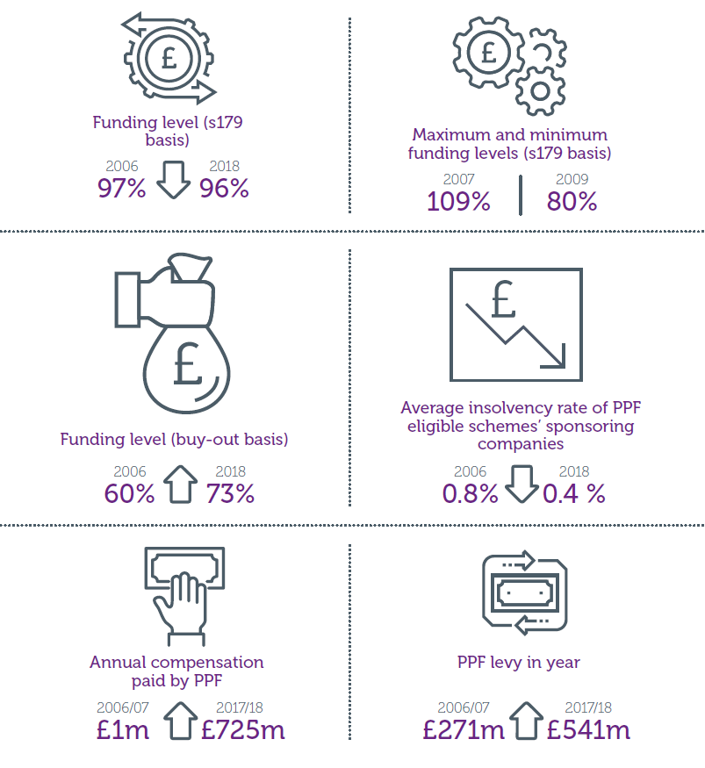
Pensions landscape – changes to PPF eligible universe (II)
Source: PPF Purple Book,
December 2018

Slide 9
s179 funding level
The s179 funding level of The Purple Book schemes has increased by 5.2 percentage points from 2017 to 2018
 | Purple Book 2018 | Purple Book 2017
Number of schemes in Purple Book dataset | 5,450 | 5,588
Assets (£b) | 1,573.3 | 1,541.1
s179 liabilities (£b) | 1,643.8 | 1,702.9
Net funding position (assets – liabilities) (£b) | 70.5 deficit | 161.8 deficit
Funding level (assets/liabilities) | 95.7% | 90.5%

Slide 10
But funding level at 31 March 2018 is just a snapshot

Slide 11
New s179 assumptions
In November 2018 new s179 assumptions were introduced. Effect is a decrease in liabilities. Impact on The Purple Book 2018 dataset from end-November PPF 7800 Index improved funding by 5.2%.
I November 2018 new s179 assumptions were introduced. Effect is a decrease in liabilities. Impact on The Purple Book 2018 dataset due in end-November PPF 7800 Index update out next week…
…but from previous estimates, we expect a decrease in liabilities, and a corresponding increase in funding underfunded under the new assumptions.
nd 5.2%.
30 June 2018, Purple Book 2017 dataset | A8 (old) assumptions | A9 (new) assumptions
Overall funding level | 94.9% | 100.2%
Deficit of schemes in deficit | £200b | £149b
Number of schemes in deficit | 3,633 | 3,188
Over 50% of schemes remain underfunded under the new assumptions.

Slide 12
Concentration of members in large schemes
Number of members | 2-99 | 100-999 | 1,000-4,999 | 5,000-9,999 | 10,000+ | Total
Number of schemes | 1,934 | 2,392 | 756 | 171 | 197 | 5,450
Assets (£b) | 16.5 | 136.1 | 258.0 | 193.5 | 969.2 | 1,573.3
s179 liabilities (£b) | 16.1 | 146.5 | 278.4 | 202.3 | 1,000.5 | 1,643.8
Members (000s) | 84 | 838 | 1,720 | 1,200 | 6,540 | 10,382
Large schemes with over 5,000 members make up around 7% of the total number of schemes in The Purple Book 2018 dataset, but…
…represent almost 75% of total assets, liabilities and members.

Slide 13
Schemes continue to close to new benefit accrual
In recent years, the proportion of schemes closed to new members has been falling as schemes have closed to new benefit accrual
Proportion of ‘Open’ schemes fell sharply between 2006 and 2010, but has changed little since 2012

Slide 14
Falling equity share, rising bond share

Slide 15
Special contributions remain high
Source: MQ5, ‘Investment by Insurance Companies, Pension Funds and Trusts’, ONS

Slide 16
Rise in risk transfer deals
Longevity swap
Buy-in
Buy-out
Two-half moving average
Source: Hymans Robertson, ‘Buy-outs, buy-ins and longevity hedging’

Slide 17
Transfer out of pension schemes

Slide 18
Recovery plans are not shortening
Tranche | Year of Valuation | Average length of recovery plan, years
1 | 2005-06 | 8.1
2 | 2006-07 | 7.7
3 | 2007-08 | 8.6
4 | 2008-09 | 9.7
5 | 2009-10 | 8.5
6 | 2010-11 | 7.8
7 | 2011-12 | 8.5
8 | 2012-13 | 8.5
9 | 2013-14 | 8.0
10 | 2014-15 | 7.5
11 | 2015-16 | 7.8
Source: ‘Scheme funding statistics, Appendix’, The Pensions Regulator, June 2018

Slide 19
PPF funding vs PPF 7800 index

Slide 20
Insolvencies remain at low levels
Insolvency events in deficit at assessment date (LHS)
Four-quarter average insolvency rate (RHS)
Insolvency events in surplus at assessment date (LHS)

Slide 21
Key insights
UK DB pension scheme universe funding level improved in The Purple Book 2018. Will improve further under new s179 assumptions, but many schemes will remain in deficit. It is these schemes we protect
s179 liability values still volatile as gilt yields move around
De-risking continues:
Moving out of equities to bonds
DRCs
Increased buy-in/out activity
PPF’s own funding level has remained robust and we remain in a strong position

Slide 22
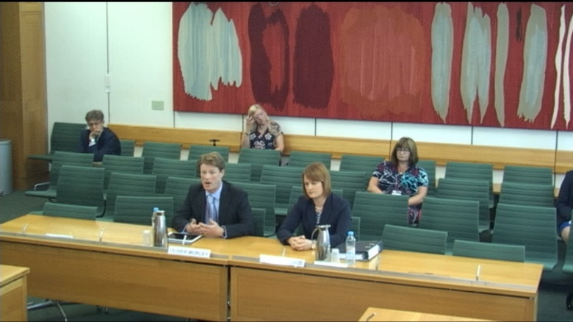
So what does the future hold?
DWP’s recent White Paper
We believe:
no systemic affordability ‘crisis’
current framework appropriate
and working well
stresses in the system
- some schemes are struggling
scope for legislative and regulatory improvement to manage risks better and improve member outcomes
better funded schemes reduce the risk to members and the PPF
We want to see:
clearer boundaries so schemes close deficits within acceptable timeframes
tackling long recovery plans
less leeway to take greater risk or back-end load recovery plans
schemes to be targeting at least PPF level benefits
an appropriate regulatory regime to support consolidators

Slide 23

DWP’s consultation on Pensions Dashboards
Pensions dashboards :
give people accurate, easy to understand, secure information
show people clearly how much they have in their pension pots and what they can expect to have to live on in retirement
put people in control of when and how they check their data and who has access to it
help people to find ‘lost’ pension pots
“Plain pensions information at the touch of a screen will
ensure better-informed, more engaged savers and help
many more people to plan effectively for retirement. Bringing
pensions information into the digital age has the potential
to revolutionise the way we all think about and plan for later
life. People, young and old, should have all the help they need to get ready for retirement and maximise their pension incomes and, working with industry, we will ensure they do.”
Guy Opperman, Minister for Pensions and Financial Inclusion, December 2018

Slide 24
PPF view
TPR powers consultation:
support intent – but detail worth developing
clearer sanctions structure - hierarchy of penalties worth considering further
areas to consider further – simplifying FSD/CN process
Pensions dashboard consultation:
strongly supportive of the underlying ambition, to enable people to engage better with their pension savings through digital channels
intend to participate and stand ready to engage with the proposed industry delivery group
proposed architecture looks reasonable but raises some issues which may have implications for DB schemes in general

Slide 25
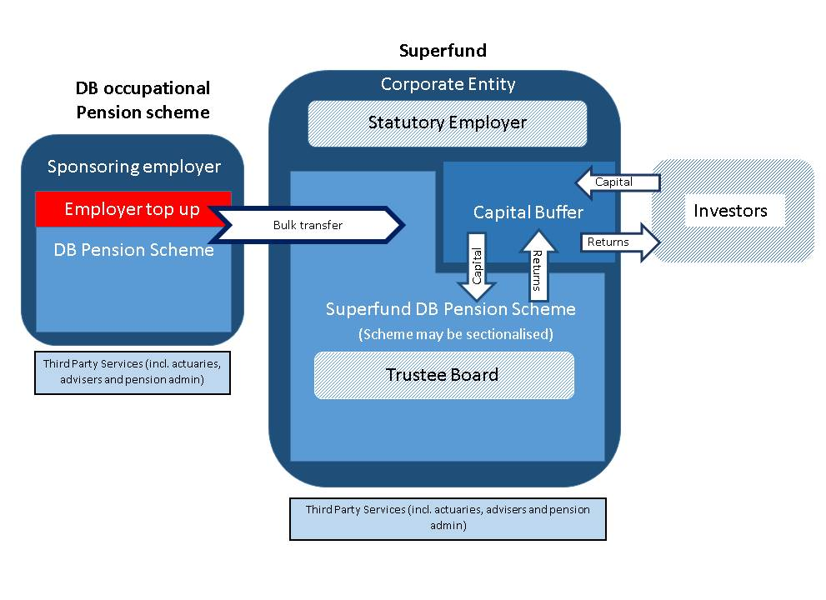
Another DWP consultation: consolidation (aka superfunds)
DWP Superfund consultation Dec 2018

Slide 26
Superfund characteristics
External capital from investors – with return (‘profit’)
Pension scheme not insurance – scheme has trustees, regulator is TPR and scheme PPF eligible
Less secure than buy-out – so DWP propose ‘gateway test’
But still expected to be low risk – demonstrated through capital adequacy requirements – at inception and ongoing
Enhanced regulatory requirements including ‘Fit and proper’ regime for key staff

Slide 27
Key policy issues to resolve
Path to buy-out or run-off vehicle?
When is it OK to take a profit?
Risk appetite – government to decide how secure superfunds must be?
How to regulate in relation to risk appetite – modelling based approach or requirements on capital /risks run
How to protect members from impact of superfund failure – should there be an opportunity to refinance once investor funds exhausted
How to protect PPF – where to set a windup trigger?

Slide 28
An opportunity, danger or irrelevance?
Opportunity | Danger | Irrelevance
Capital contribution improves funding position of scheme | No employer covenant so investment strategy failure = claim on PPF | Capital required means few low security schemes can take up?
External capital provides additional resources | Levers on investment strategy not in trustees’ hands (e.g for buffer) | Gateway test to prevent the ‘buy out able’ from dumbing down
In combination these allow lower risk investment strategies | Increased scale means risks concentrated | Regulation required to ensure low risk means high entry cost
Increased scale of schemes reduces costs | Investment strategies likely to be correlated? | Not clear will be trustee appetite?
Scale allows for better investment and governance | Governance complex
A bridge to buyout? With benefit reduction could help stressed schemes? | Diverts schemes from buy-out?

Slide 29
PPF view
‘Superfunds’ consultation:
well-run superfunds have potential to increase security for some DB schemes and can play a helpful part
there are significant risks to the PPF, PPF members, levy payers and members of the schemes we would support if ‘superfunds’ fail
any ‘superfund’ must:
give confidence it will pay its members in full and won’t claim on the PPF
have appropriate regulatory framework including ‘wind-up triggers’
be financially robust
have strong governance
PPF levy for ‘superfunds’:
Levy for strongly funded, well run consolidators will be small
Less well-funded schemes who aren’t protecting levy payers and members may face substantial levy
Levy rule will continue to evolve
Goal: a robust transparent methodology that delivers a risk reflective levy

Slide 30

Questions?

