Slide 1
Protecting People’s Futures
David Taylor – Director of Strategy and Legal Affairs
Occupational Pensioners Alliance – 20 February 2014

Slide 2
Introduction
Our current position
Our objectives and long term strategy
How we are funded
Our involvement in restructuring agreements
The PPF going forward
Notes:
Timely event at the PPF approaches its 10 year of operation
Will begin with giving some background into our objectives and long term goals
Will briefly touch on how we are funded: the levy, through schemes transferring to us and through restructuring agreements.
Given recent press coverage, I will explain where and when we become involved in these agreements and hope to debug some myths.
Finally, I’ll talk about the challenges that lie ahead.

Slide 3

The PPF today
We protect 6,225 eligible DB pension schemes with £1 trillion liabilities and 11.4 million members
189,000 PPF members transferred from 634 schemes
Over £1 billion in PPF compensation paid
133,000 members in assessment
165,000 FAS members
£420 million in FAS assistance paid
1050 FAS schemes qualified
Notes:
This is the PPF today at a glance
When we opened our doors in 2005, we protected 7,800 schemes – this has rapidly decreased to the 6,225 we protect today.
Regardless of whether schemes are in the PPF, we still offer them protection in the event their company fails – and so we have a very important role to play in helping to prevent repetitions of situations as shown in the photo – the Pensions Action Group demonstrating outside of the Houses of Parliament.
In addition to providing compensation to our PPF members, we manage the FAS – which is a declining book.

Slide 4
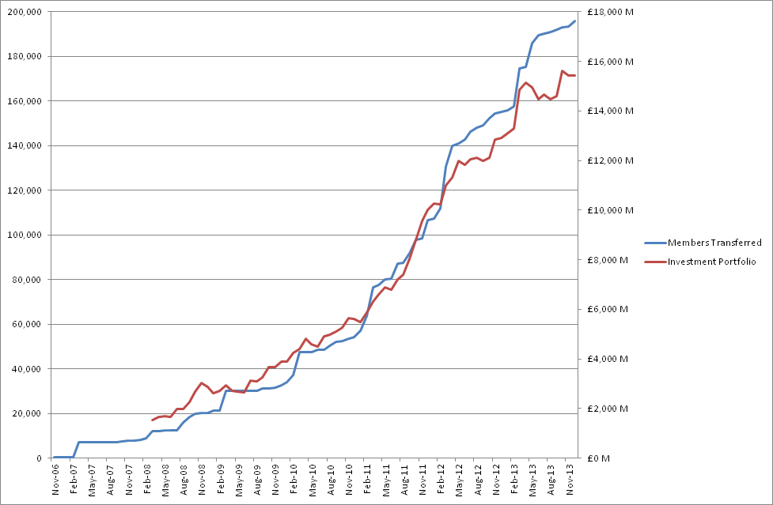
We’ve grown rapidly since we were set up
Notes:
This gives you an idea of how quickly we have grown, both in terms of members and investment.
Our investment strategy plays a vital role in helping us to be able to pay our members.

Slide 5
Our three strategic objectives
Meet our funding target
Deliver excellent customer service
Effectively manage our risk
Notes:
We currently have three strategic objectives which we focus our work on and measure against to see how we are performing:
Meet our funding target - through prudent and effective management of our balance sheet
Deliver excellent customer service - to our members, levy payers and other stakeholders (political / industry experts)
Effectively manage our risk - pursue our mission within a high calibre framework of risk management
Our mission is to ‘pay the right person, the right amount at the right time’.
This all underpins our goal in being able to pay compensation to our members, which drives all aspects of our business as we are the safety net for all DB schemes in the UK.

Slide 6
Meeting our funding target
We aim to be ‘self-sufficient’ by 2030
This means by 2030, we expect:
To have a balance sheet of around £80 billion
Pension schemes will either be well-funded, bought out in the market or have come to the PPF
There will be a minimal levy
Claims on the PPF will be minimal
Notes:
We have set our long term strategy as becoming self-sufficient by 2030 for these reasons.
We measure the likelihood of achieving this goal with the ‘probability of success’ on an annual basis.
Our 2013/14 target is 83% however we are currently at 87 per cent.

Slide 7
Our financial position remains strong
2012/13 saw:
over £1 billion worth of inherited deficits
a collected levy of around £630 million
our surplus increase to £1.9 billion (109.6% funded)
Notes:
The levy has been pretty stable over the past few years, thanks to the new levy framework which aims to give greater stability and predictability to our levy payers.
Claims however have fluctuated somewhat in comparison:
2012/13 saw the year with the highest amount of claims to the PPF.
Claims to date 2013/14 (as at 30 Nov) - £340 million – however this is expected to grow slightly with recent large claims
Despite the recent high claims, we remain resilient and on course to meeting our 2030 goal.

Slide 8
How the PPF is funded
Levy
Scheme Assets & Recoveries
Investment Returns
£££
Current Member Compensation
Future Member Compensation
PPF costs
Notes:
The PPF has three main funding streams: the levy, scheme assets and recoveries. This is invested and used to pay compensation.
It is important to stress that all of the funds go into one pot, along with our investment returns (which was 11% for the last financial year).
The pension scheme therefore no longer exists.
As at the end of November 2013, we had:
Assets to date - £8.31 billion
AUM - £15.6 billion
2012/13 Levy - £630 million collected
Over £1 billion paid in PPF compensation

Slide 9
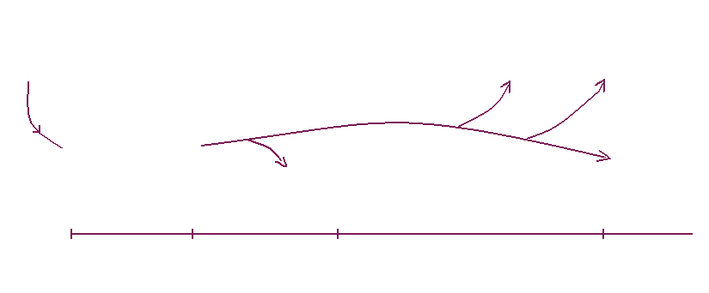
How schemes enter the PPF
Our mission: to pay the right person, the right amount, at the right time
Insolvency
Rescue
Buyout
Enter
Assessment
Compensation
Rejection
Assessment Period
Compensation
Notes:
This gives an idea of what is involved in the assessment period.
It is important to highlight that it is an involved process which can often take several years.
The industry average is around 8 years, however we have brought that substantially down to 1 to 2 years, and even to a few months in some cases.
One of the biggest problems we face is the quality of data that pension schemes hold on their members. This can often cause ‘hold ups’ in the scheme ‘progressing’ through the assessment period.

Slide 10
The Pension Protection Levy
It is risk-based and is calculated by looking at the likelihood of employer insolvency and the funding position of the scheme
We have fixed some of the factors in calculating the levy to offer greater predictability for pension schemes
For the 2013/14 year we set our levy estimate at £630 million. This rose to £695 million for 2014/15.
The average levy bill for 2013/14 is £94,062, with bills ranging from £1 to £18,000,000.
We are currently undertaking our three yearly review of the levy rules and are switching our insolvency provider to Experian.
Notes:
A new ‘framework’ was put into place in the 2011/12 levy year with the aim to give more predictability and stability to our levy payers as some of the parameters are fixed over a three year period.
The way the levy is calculated is based on how risky the pension scheme and its employer are, and how well the scheme is funded.
We expect the levy to increase by ten per cent for 2015/16 – this is a reflection of the risk with the pension schemes we protect.
As you can see, levy bills vary - both the £1 and £18m bills have been paid, without appeals.
We are changing who calculates the insolvency risk of employers from D&B to Experian – work is on going in developing a PPF-specific model that will be ‘fit for purpose’ and measure risk in our universe accurately.

Slide 11
Restructuring and insolvency: where we get involved
Two main areas:
Insolvency of corporate sponsors
Restructurings:
Compromise agreements – with a Regulated Apportionment Arrangement (RAA)
Company Voluntary Arrangements (CVAs)
The PPF takes over the creditor rights of the pension scheme
Notes:
Now will take some time to explain where and when the PPF becomes involved in restructuring agreements.
Firstly the when …

Slide 12
When we will become involved in ‘deals’
Essential that employer insolvency is inevitable
Outcome demonstrably better in RAA than insolvency
Anti-embarrassment equity – 10% or 33%
A better outcome is not possible by other means (including use of the Pensions Regulator’s (tPR’s) powers)
tPR clearance and PPF non-objection required
PPF/trustee costs to be covered by the employer
Equitable treatment of scheme against other creditors and shareholders
Notes:
We do not enter restructuring agreements lightly
Fundamentally, the agreement needs to demonstrate a clear benefit to our levy payers and that the employer would have become insolvent anyway.

Slide 13
Attitude of the courts – the Ilford case
Notes:
So far, we have recovered in excess of £1.5bn – as at November 2013
Here are some high profile cases you may have heard about…

Slide 14
Deliver excellent customer service
We anticipate having more than 300,000 PPF members
Providing member services in-house is now a viable option given our projected size
We currently have very good levels of customer satisfaction
Bringing our member services in-house will give us greater control and flexibility, and allow us to benefit from economies of scale
Notes:
We have appointed Civica to provide our administration and payroll software
We are working with trustees and administrators to ensure we continue to strive for the highest standards in customer service
Up to 100 new roles are being created
In the meantime, our members will continue to receive payments as usual

Slide 15
Changes to the regulatory landscape
Defined Ambition
The Pensions Regulator’s new growth objective
The possible EU solvency-style measures for pension funds
Changes to the PPF’s compensation cap
Bridge
Notes:
Looking ahead to other challenges on the horizon, we are currently keeping an eye on these regulatory developments.

Slide 16
Summary
We remain financially resilient and on track for our 2030 funding target
Growing scale and maturity – reflected in our commitment to customer service in bringing member services in-house
Still scope to improve and develop – considering changes to how our levy is calculated
Clear principles for entering into restructuring agreements - only if it will benefit our levy payers
Looking at our changing risks, including regulatory changes, to ensure we can continue to ‘Protect People’s Futures’

Slide 17
Thank you for listening
Any questions?

